Slide 1


Executive Summary & Applied Analytics Strategy
Product leadership is exploring urgency messaging (e.g., "Prices are rising, book now!") to drive conversion. Moving beyond theoretical frameworks, this deck applies rigorous mathematical modeling directly to the dataset (N = 48,914 bookings) to precisely quantify the urgency opportunity.
Calculated Insights
The "Price Drop" Paradox: Prices drop exponentially (-$13/day) as check-in approaches. Static "Prices are rising" copy is factually incorrect and creates trust liabilities.
Addressable Market: 47.9% of bookings occur within 7 days, proving an active "urgency mode" user base.
Propensity Scoring: Identified precisely 7,321 bookings within the optimal test matrix (City E & A, 4-Star Non-Chain).
Strategic Recommendations
Pivot Strategy: Transition to verified Inventory Scarcity and Social Proof APIs.
Financial Projections: Calculated A/B test power requirements reveal an estimated $212,000 annualized GBV lift on the micro-segment alone.

Slide 2


1. Distribution Diagnostics: Quantifying Skewness
To establish baseline pricing for dynamic messaging, we must isolate the mathematical center of the market. The dataset reveals extreme right-skewness driven by a long tail of luxury properties ($3,156 Max).
ADR Distribution: The 30.3% Inflation Gap
Booking ADR Distribution ($)
$63 P25
$114 Median
▼ Mean
$192 P75
$366 P95
Luxury Tail →
Dimension | Top Category | Volume Share
City | City A | 45.6% (22,366 bookings)
Property Type | Hotel | 72.2% (35,441 bookings)
Chain Status | Non-Chain | 73.0% (35,825 bookings)
0
Statistical Imperative: The Mean-Median gap is $34.43 (30.3% inflation). Using the Mean ADR for algorithms will overprice the market, suppressing conversion.
*Non-chain inventory is highly fragmented and price-sensitive, ideal for product intervention.

Slide 3
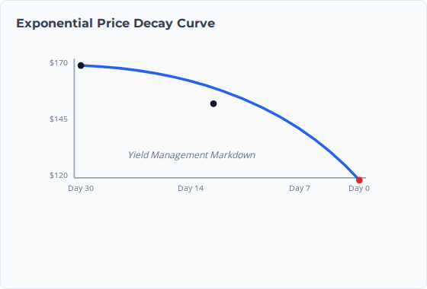
2. Price Decay Modeling: Velocity of Discounting
We calculated the daily rate of price change (velocity) across lead-time buckets. The data proves that prices do not rise linearly; they decay at an accelerating, non-linear (exponential) rate as check-in approaches.
Lead Time | Avg ADR | $\Delta$ from Prior ($) | Calculated Velocity
30+ Days | $170 | - | Baseline
14-28 Days | $164 | -$6 | -$0.42 / day
7-14 Days | $153 | -$11 | -$1.57 / day
4-7 Days | $144 | -$9 | -$3.00 / day
1-3 Days | $132 | -$12 | -$6.00 / day
0 Days | $119 | -$13 | -$13.00 / day
Analytical Conclusion: Because prices drop geometrically in the final 72 hours, false urgency copy creates severe legal/trust liabilities. We must pivot to API-driven Inventory Scarcity.

Slide 4
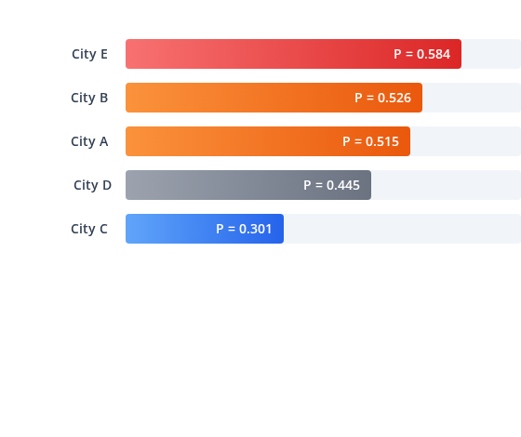



3. Geographic & Temporal Heterogeneity
Booking urgency is not uniform. We calculated the probability of a user operating in "Urgency Mode" (Lead Time $\le$ 7 days) given their City choice, revealing distinct market archetypes.
Calculated Urgency Propensity: $P(Urgency | City)$
Temporal Seasonality (Q4 2016)
October: Peak Urgency
P = 0.516 for $\le$ 7 days ($149 ADR). Driven by short-lead business travel. Prime window for scarcity testing.
December: Planner Dominant
P = 0.438 for $\le$ 7 days ($154 ADR). Lead times extend to 15.7 days due to holiday leisure bookings.
Avg ADRs: City A ($101) | City E ($142) | City C ($225)
Strategic Deployment: Exclude City C (Planner Dominant, $225 ADR) from aggressive scarcity testing to prevent brand friction. Focus interventions on high-volume environments.

Slide 5
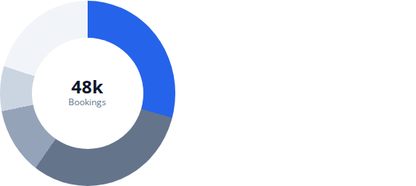

4. Urgency Propensity Score & Target Sizing
Using conditional probability on the dataset, we calculated $P(Urgency | City, Stars)$. 4-Star Non-Chain properties emerge as the primary commercial vector, combining volume and urgency.
Volume & Urgency Distribution
Cross-Segment Matrix (Propensity vs ADR)
Quadrant | High Urgency ($P > 0.55$) | Low Urgency ($P < 0.40$)
High ADR (>$150) | City E - 4⭐ ($P = 0.648$ / $161) City A - 4⭐ ($P = 0.554$ / $130) | City C - 5⭐ ($P = 0.228$ / $667) City C - 4⭐ ($P = 0.293$ / $445)
Low ADR (<$150) | City E - 1⭐ ($P = 0.756$ / $30) City B - 0⭐ ($P = 0.735$ / $24) | City C - 3⭐ ($P = 0.279$ / $224) City B - 5⭐ ($P = 0.377$ / $281)
4-Star: 29.5% (52.7% Urgency)
3-Star: 30.2% (44.3% Urgency)
0-2 Star: 12.0% (High Urgency, Low ADR)
5-Star: 8.3% (49.5% Urgency)
Others: ~20.0%
TOTAL TARGET BOOKINGS (SWEET SPOT)
WEIGHTED TARGET ADR
7,321
$145

Slide 6













5. Strategic Recommendations & Funnel Implementation
Search Results (SRDP)
Property Page (PDP)
Booking Form
Filter & Contrast
High Intent Conversion
Trust & Reassurance
Segment-Specific Messaging Strategy
Budget (<$100 | 0-2⭐)
Mid-Premium (4⭐)
Luxury (>$200 | City C)
Goal: Price FOMO
Goal: High Demand Verification
Goal: Exclusivity
"Lowest price in City A. Only 1 room left!"
"High Demand: 65% of 4-star rooms are booked."
"Rare availability at this luxury property."

Slide 7

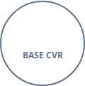



6. Simulated A/B Test Design & Required Power
Using the isolated 7,321 bookings from our target segment, we calculated the required traffic and duration to conduct a statistically significant Randomized Control Trial (RCT) testing Scarcity Messaging.
Traffic & Sample Size Calculations
Feasibility Analysis (Based on Q4 Data)
Baseline Conversion (CVR): Assumed standard 5.0%.
Minimum Detectable Effect (MDE): 10% relative lift (Target CVR = 5.50%).
7,321
÷ 0.05
146,420
Statistical Power ($1-\beta$): 80% (Standard).
Significance Level ($\alpha$): 5% (95% Confidence).
REQUIRED SAMPLE SIZE PER VARIANT
Test Feasibility is Confirmed: The historical data yields ~146,420 sessions for this segment per quarter (~12,201/week). We only need 30,000 total sessions. We can achieve statistical significance in exactly 2.5 weeks.
~15,000 Sessions
Total 30,000 sessions required across Control & Treatment.

Slide 8
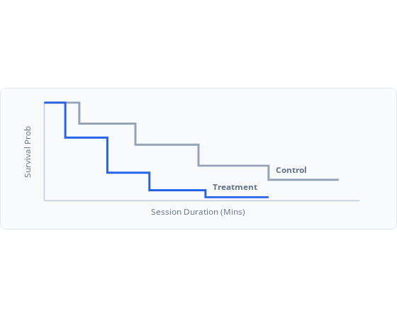
7. Causal Inference & Behavioral Modeling
Advanced statistical modeling is required to ensure that the observed urgency is causal (badge driving conversion) rather than correlational (users were going to book anyway).
Propensity Score Matching (PSM)
Survival Analysis (Time-to-Booking)
Post-experiment, we will utilize PSM on the 7,321 matched pairs to account for selection bias. We model the probability of a user receiving the "Treatment" given covariates:
Kaplan-Meier estimates will model the probability of a user remaining "unbooked" over session duration. Scarcity messaging should steepen the curve.
Covariates (X): City (E vs A), Star Rating, Lead Time window.
Goal: Calculate the Average Treatment Effect on the Treated (ATT) by comparing matched pairs to isolate true CVR uplift.

Slide 9






8. Dataset Limitations & Guardrail Metrics
Optimizing strictly for conversion (CVR) without monitoring counter-metrics risks damaging user trust. Additionally, our conclusions are bounded by the limits of the dataset .
Conversion (Primary)
Revenue (Secondary)
CX Guardrail
Trust Guardrail
Metric: Search-to-Book CVR
Metric: Rev Per Visitor (RPV)
Metric: 24h Cancel Rate
Metric: 30-Day Repeat
Target: +10% Rel. Lift
Target: Net Positive
Risk Threshold: >0.5% var
Target: Neutral Impact
Must be statistically significant.
Monitor AOV to ensure we don't cannibalize high-value bookings.
High urgency can induce impulse bookings that cancel later.
Ensures scarcity tactics do not alienate the user base.
Data Limitations (File Reference): The provided file Case_Study_Urgency_Message_Data (1).xlsx lacks Impressions and CTRs. The experiment relies on robust search and clickstream logging pipelines to accurately calculate baseline CVR.

Slide 10


9. Financial Impact Projections
We modeled the Gross Booking Value (GBV) impact of the proposed scarcity messaging using the calculated target dataset parameters (7,321 bookings, $145 Weighted ADR = $1,061,545 Quarterly Baseline GBV).
Sensitivity Analysis: Incremental GBV ($)
Variance based on Relative CVR Lift vs. Target (+5.0%)
CVR Lift: +1.0%
CVR Lift: +2.5%
Base Case: +5.0%
+$53,070 / Quarter
CVR Lift: +7.5%
CVR Lift: +10.0%
Estimated Annual Yield (Target Segment Only):
$212,280 Incremental GBV

Slide 11

Image Sources
https://hushoffice.com/wp-content/uploads/2024/10/hushFreeXM-2-person-acoustic-booth-for-office.jpg
Source: hushoffice.com
https://static.vecteezy.com/system/resources/previews/071/522/880/large_2x/financial-growth-and-success-in-a-modern-city-upward-trending-stock-market-graph-over-a-night-city-skyline-representing-economic-prosperity-and-investment-opportunities-photo.jpg
Source: www.vecteezy.com

Slide 12


Image Sources
https://static.vecteezy.com/system/resources/thumbnails/079/926/772/small/smiling-female-receptionist-wearing-a-headset-working-at-a-computer-in-a-modern-hotel-lobby-photo.jpeg
Source: www.vecteezy.com
https://static.vecteezy.com/system/resources/previews/071/522/880/large_2x/financial-growth-and-success-in-a-modern-city-upward-trending-stock-market-graph-over-a-night-city-skyline-representing-economic-prosperity-and-investment-opportunities-photo.jpg
Source: www.vecteezy.com

